Slide 1
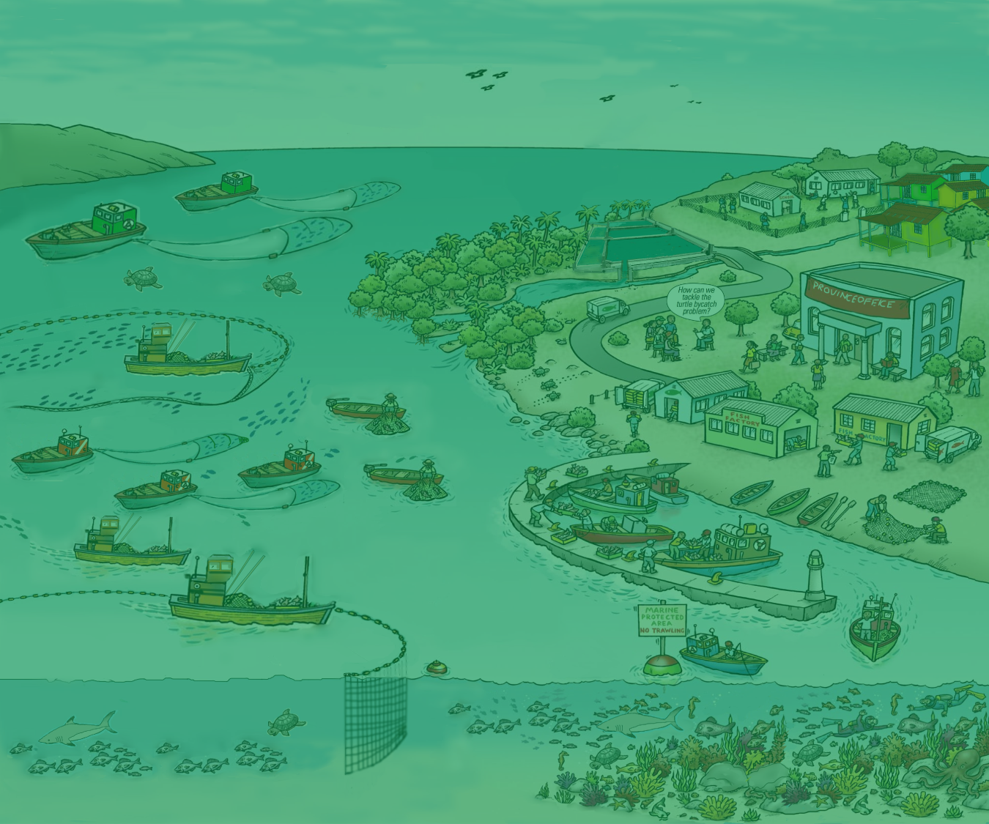
9. EAFM Developing Capacity
Version 1

Slide 2
Session objectives
After this session you will be able to:
Identify EAFM capacity development needs
Identify how to support the development of capacity in EAFM
2
Notes:
Self explanatory

Slide 3
Activity: Developing Capacity
What are the capacity needs of your staff/agency in EAFM?
What are some creative ways that you can help develop capacity in EAFM?
How would you influence other leaders to support EAFM?
3
Notes:
Activity to promote think about building human capacity

Slide 4
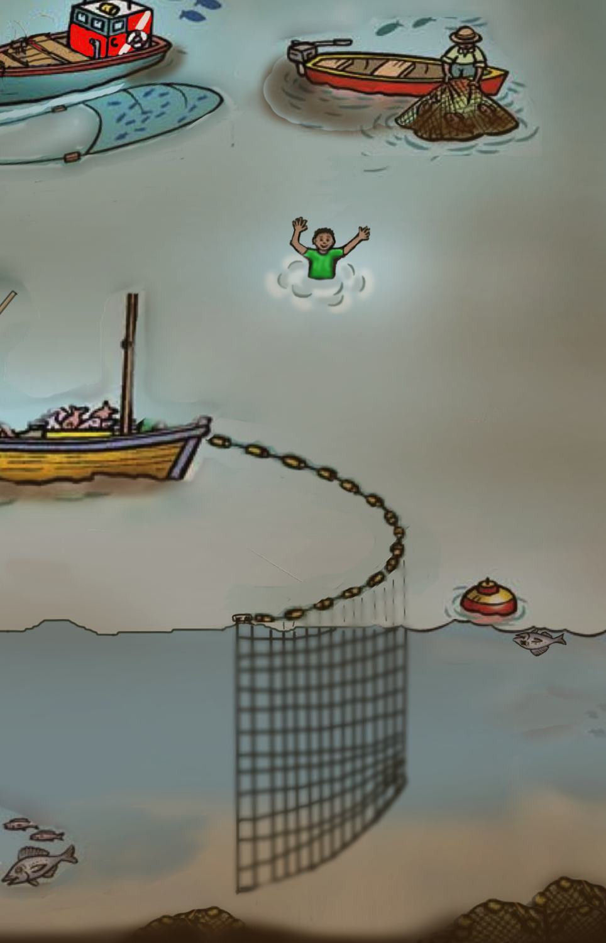
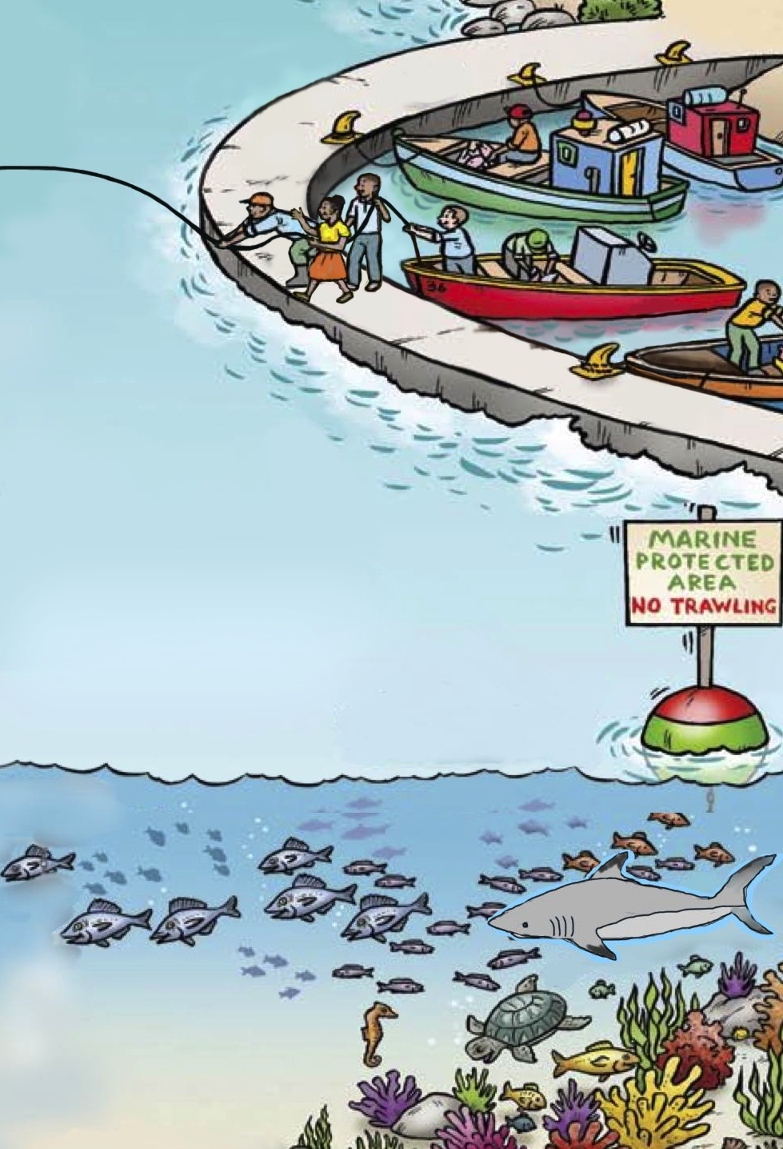
Help is at hand!
Images adapted from FAO EAF Nansen Project

Slide 5
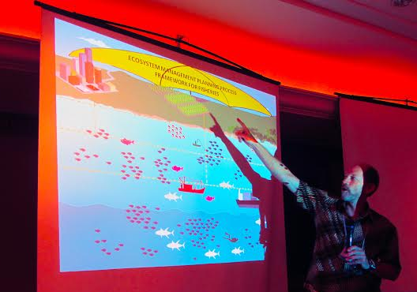
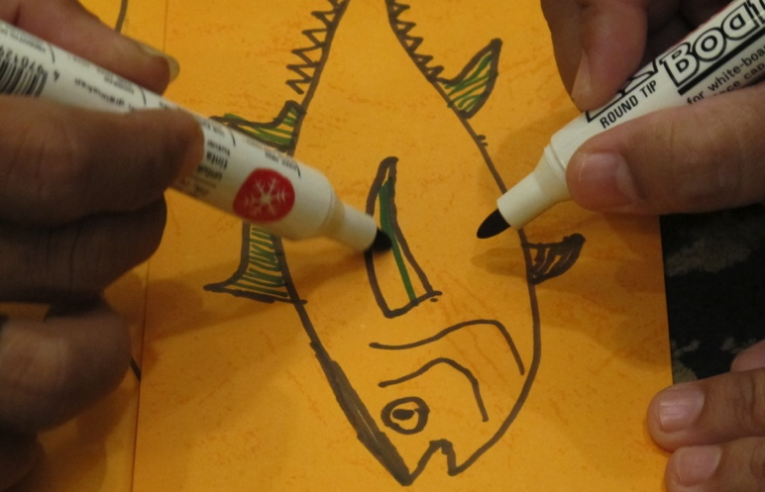
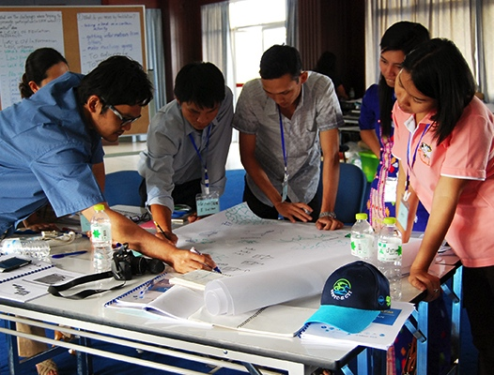
Essential EAFM training package
EAFM LEAD (leaders, executives, and decision makers) “tool box”
Regional trainers and training institutions
www.eafmlearn.org
Notes:
The E-EAFM course is a week-long comprehensive, hands on course to help staff involved in fisheries and environmental management implement EAFM and manage fisheries more sustainably.
The LEAD “tool box” has useful tools ranging from a 1 minute script and short videos through to a 1-day Executive Consultation that will help raise awareness and gain support of other leaders
Throughout various regions of the World, especially in Southeast and South Asia there are a large number of trainers qualified to assist in E-EAFM and LEAD and a number of training institutions have been established.
Find out more from EAFMLEARN.ORG

